Slide 1
Heterogeneous firing rates modeled in densely connected recurrent neural networks
Kendrick Tang
Dr. Eric Shea-Brown
Yu Hu

Slide 2

Introduction to neurons
External and neuron to neuron inputs are received by neurons and encoded
Light; rods and cones; and bipolar and ganglion cells
In our model input is average current: E
neuron
?
Neural encoding
input stimuli
$$E_{i}$$
Notes:
Neurons take input from both external sources and other neurons. For example, light, an external source, is received by rods and cones, neurons, which then send signals to bipolar and ganglion cells, other neurons.
In our model the input will always be represented by a current, regardless of it’s source. We’ll represent current by the letter E.
In the diagram you can see an input from an ambiguous source which gets encoded by a neuron, but how this actually happens is still not fully understood.

Slide 3
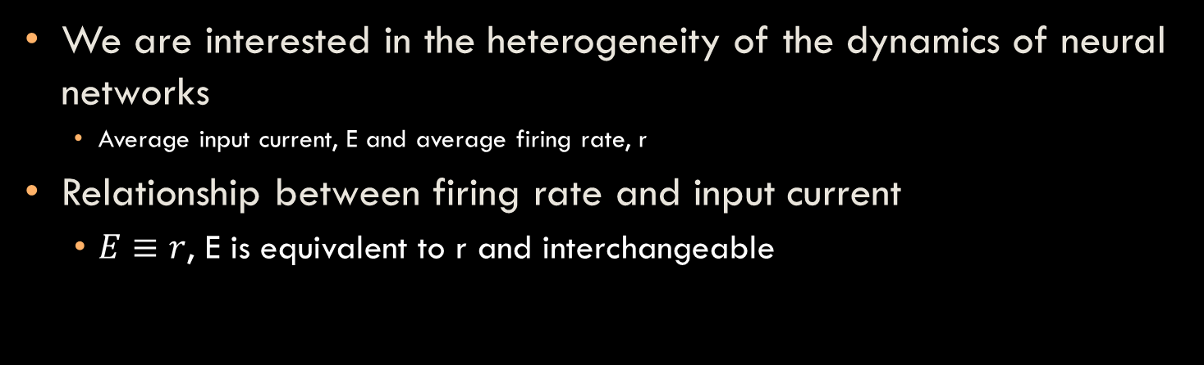
Heterogeneous firing rates in a neural network
We are interested in the heterogeneity of the dynamics of neural networks
Average input current, E and average firing rate, r
Relationship between firing rate and input current
$E≡r$, E is equivalent to r and interchangeable
Notes:
What we are interested in is the heterogeneity of the dynamics in a neural network. The dynamics of our networks are the current levels, and firing rates. There’s a very nice one-to-one relationship between the average current input and the average firing rate produced, plotted here. You can see that as the current increases, the firing rate also increases, but this relationship is asymptotic which just represents the physical limitations on the firing rate a neuron has. There is a limit to how fast a neuron can fire. This relationship allows us to interchange the currents and firing rates of a neuron, which allows us to go back and forth between those values when considering the heterogeneity.
By heterogeneity I just mean that the neuron’s have varying currents or firing rates. We’re interested in the heterogeneity because it has been shown to improve encoding capabilities of neural networks. Intuitively, you can imagine a network with homogenous dynamics trying to encode information, homogenous meaning all neurons are doing the same exact thing. One way to do this is Morse code, which is highly inefficient. In a heterogeneous network, neuron activity patterns are much more diverse and have a much larger capacity for encoding information.

Slide 4
Creating a neural network
Networks must support heterogeneity
Networks with non-uniform (heterogeneous) firing:
All to all connected network of non-uniform neurons
Connection matrix W
In-degree: the number of connections into each neuron
1 | 1 | 1 | 1 | 1
1 | 1 | 1 | 1 | 1
1 | 1 | 1 | 1 | 1
1 | 1 | 1 | 1 | 1
1 | 1 | 1 | 1 | 1
Notes:
The first step in modeling a network is to actually create a network, but we can only consider networks that support heterogeneous activity.
There are two natural ways to do this. We could create an all to all connected network of non-uniform neurons, where the heterogeneity between neuron properties is the source for heterogeneity in the network activity. Below is a graphical and matrix representation of an all to all connected network
We store all our network architecture information in a connection matrix W where the ij entry represents the connection strength from the jth neuron to the ith neuron. In an all to all connected network, this matrix would be all ones because all the connections exist. One important characteristic of the network is the in-degree, which is the number of connections into each neuron. In an all to all connected network, the in-degree for each neuron would just be the total number of neurons. For example, the in-degree for this network would be 5 because neuron’s can be connected to themselves.
However, since the structure of a network is a very physical and observable property, we want to find a relationship between the structure of a network, and it’s heterogeneity.

Slide 5
Creating a neural network
1
4
0 | 1 | 0 | 0 | 0
0 | 0 | 0 | 0 | 1
1 | 0 | 0 | 1 | 0
0 | 0 | 1 | 0 | 0
0 | 0 | 0 | 0 | 0
3
5
2
Erdos-Renyi random graph model:
Parameters: network size, probability, connection strength
Notes:
To do this we’ll create a random graph of identical neurons. For example, we can consider 5 identical neurons, and randomly create paths between them. First we’ll check the connections for the first neuron, and do the same for the second. Here you see that two is connected to one even though one wasn’t connected to two. In our model, we are consider directed connections, which means the direction of a connection matters. Neuron one, in this network, does not have a connection with neuron two. We can continue this for all the other connection pairs.
To mathematically model this we used a erdos- renyi random graph technique which takes 3 parameters. The first one is the number of nodes, which represents the size of the network. The next one is the path probability. We used a probability of 20% which classifies our network as dense. This probability determines whether or not each path exists, so for each component of the matrix we’ll flip a coin weighted to 20% to see whether or not a path exists. The last parameter is the connection strength, which plays a role in the network dynamics. If the connection strength is strong, then the neuron’s are very sensitive to each other, which means there will be more correlation between them.

Slide 6

Mathematically modeling network activity
Modeling a neural network with a dynamical equation $\left[1\right]$:
$$E_{i}=E_{0}+\sum_{j}{W_{ij}r\left(E_{j}\right)}$$
We are interested in solving this equation, or determining steady-state of the network
Different connection structures as well as strengths are tested
[1] James Trousdale, Yu Hu, Eric Shea-Brown, Kresimir Josic. Impact of Network Structure and Cellular Response on Spike Time Correlations. PLOS Computational Biology, volume 8, issue 3, pg 14.
Notes:
To actually model network activity we use this dynamical equation. Recall that E represents current, which means E_i is the current into the ith neuron, and r(E_j) is the firing rate of the jth neuron. This equation says that the current into the ith neuron is equal to the sum of the firing rates of all the other neurons, weighted by their connection strengths with the ith neuron. There’s also an E_0 term, which is just a white noise constant -52 mV which all neuron’s experience.
We are interested in solving this equation for when E on the left side is equal to E on the right side, which we’ll define as the steady-state of the network, or when the current distribution is balanced in the network.
While E is the variable in this equation, we’re actually looking at the dynamics of the steady-states as a function of W, or the connection structure.
To actually find solutions to this equation, we used a numerical approach, which just means we used a computer.

Slide 7
Searching for steady-states: numerically
Iteration method
Testing for existence
Testing for uniqueness
Two different networks, different connection strengths tested
Average current (mV)
Connection strength
Neuron index
Notes:
We used an iteration method, where we iterated the equation as many times as we needed until the values stopped changing, given an initial value. We then compared the steady-states produced by other initial values to make sure the solution was a unique solution. We did this for over 400 different networks and 30 different connection strengths for each network.
These are fixed point plots for two networks. You can see that these networks both had 50 neurons, and you can see the steady-state solution to the equation for all 30 connection strengths.
You can also see that the networks really are producing heterogeneous activity. Taking a strip of data across the neuron index axis represents what the network dynamics look like for a certain connection strength, and you can see that the values between neurons are very different. From all of this data we tried to form a correlation between the architecture and the variance of the steady-states.

Slide 8
Architecture vs network heterogeneity
R = 0.5815
Notes:
On the x axis we have the variance of the in-degree of 100 different networks, and on the y-axis we variance of the firing rates of all the networks at a connection strength of 200. you can see that there is a correlation between the in-degree and the firing rates, even if the direction isn’t what we expected. It’s actually a really weird correlation since you’d expect a low variance in the in-degree to represent a very homogenous network.
The next step is to look into why this correlation exists, but to also develop a much better correlated relationship.

Slide 9
The next step
Relating frequencies of three-cell motifs to activity patterns
Divergent
Convergent
Chain
Goal: define a strong relationship between the in-degree and three cell motifs with the heterogeneity of a neural network to help improve neural encoding models
1
2
3
Notes:
So another network property we can quantify is the frequencies of three –cell motifs. These are divergent, convergent, and chain motifs. We’re hoping that since these are more complex structures that better describe the architecture, they’ll be better indicators of the heterogeneity of the networks.

Slide 10
Acknowledgements
I would like to thank my principal investigator Eric Shea-Brown and mentor Yu Hu for helping and leading me through this project. I would also like to thank the rest of the Shea-Brown lab with helping me with technical difficulties, especially Yoni Browning and Nicholas Cain. Also, thanks to David Leen for helping me out with my poster and presentation.
Special thanks to Amgen for financially supporting this endeavor.
Notes:
Thanks to my mommy, and my daddy, and my mentor Mr. Eric

Slide 11
Spike counting vs spike correlation
Counting isolated neuron spiking in a decision making model
Integrate and fire model
Spike counting and bins
Notes:
A common decision making model uses neuron dynamics governed by the integrate and fire differential equation and spiking mechanism plotted below. When the voltage reaches a threshold voltage it spikes, gets reset to the reset voltage and rests for a refractory period before being active again. Each time an excitatory neuron fires, we put one count in the positive bin, and each time an inhibitory neuron fires we put one count in the negative bin, and which ever bin fills up first represents the decision. However, this model, and models like this one only consider individual spikes as isolated events and don’t consider the correlation between spikes, or spike patterns across a network.

Slide 12
Creating a neural network
Inhibitory-excitatory networks with balanced input
1
0 | 1 | 0 | 1 | 0
0 | 0 | -1 | 0 | 1
0 | 0 | -1 | 1 | 0
0 | 0 | 0 | 0 | 0
0 | 0 | 0 | 0 | 0
4
3
5
2
Notes:
We can also create mixed networks with both inhibitory and excitatory networks, IE networks. The inhibitory neuron is represented here by a green dot, and you can see that the respective column in the W matrix is all negative. We’ll represent inhibitory connections with negative values, and excitatory ones with positive values. We assume balanced input, which means the average input into each neuron is 0. However, our networks are randomly generated so this is almost never the case. The balanced input will keep IE networks closer to a natural state than the purely excitatory ones, which will play a role in the network dynamics later.

Slide 13
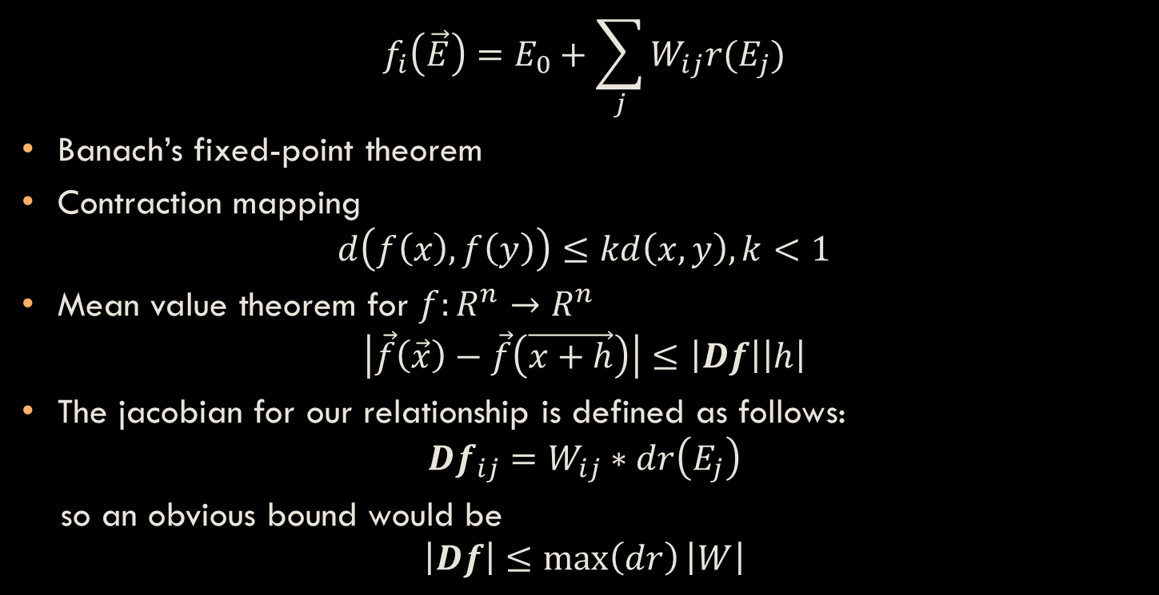
Searching for steady-states: analytically
$$f_{i}\left(\vec{E}\right)=E_{0}+\sum_{j}{W_{ij}r(E_{j})}$$
Banach’s fixed-point theorem
Contraction mapping
$$d\left(f\left(x\right),f\left(y\right)\right)≤kd\left(x,y\right), k<1$$
Mean value theorem for $f:R^{n}→R^{n}$
$$\left|\vec{f}\left(\vec{x}\right)−\vec{f}\left(\vec{x+h}\right)\right|≤\left|Df\right|\left|h\right|$$
The jacobian for our relationship is defined as follows:
$$Df_{ij}=W_{ij}∗dr\left(E_{j}\right)$$
so an obvious bound would be
$$\left|Df\right|≤\max\left(dr\right)\left|W\right|$$
Notes:
Banachs says every contraction mapping has a unique fixed point, in other words, if we iterate the function we’ll arrive at the fixed point, the steady state.
Contraction mappings are any functions that satisfy this inequality, where d is any distance equation and k a constant.
To show our function is a contraction mapping we used the mean value theorem, applied an integral inequality and holder’s inequality to arrive at this simple inequality. From here you can see on the left side we have the distance between f(x) and f(x+h), which is bounded by a constant times the distance between x and x+h. In other words, we just need to show that the jacobian has norm bounded by 1 to show it is a contraction.
The ij component of the jacobian is defined as the derivative of the firing rateof the jth neuron, times the weight into the ith neruon. An obvious bound to take would be to factor out the max value of r’.

Slide 14
Preliminary Results
Fixed point properties between E and IE networks are different
E has very positive and linear growth, always converges
IE has less linear growth in both directions, doesn’t always converge
Larger network size increases the average in-degree
Linearity is preserved in larger networks for only E networks
Steeper relationship between fixed points and connection strengths
Notes:
Read the slide.

